Slide 1
Student Information System
XJCO3011 Web Services and Web Data
Guo Mohan
2021110028

Slide 2
Project Overview and Objectives
Build a database-backed student information system
Support user authentication and linked student profiles
Provide course enrolment and timetable functions
Expose student CRUD operations through JSON API endpoints

Slide 3
Technology Stack and Design Rationale
Technology | Why Chosen
Python | Simple and suitable for rapid development
Django | Built-in auth, ORM, routing, forms, templates
SQLite | Lightweight and easy for coursework-scale deployment

Slide 4
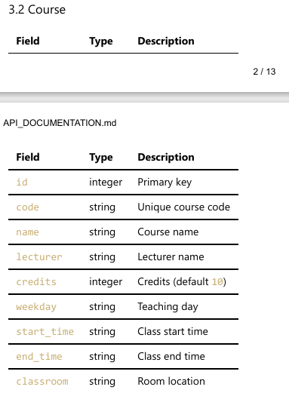
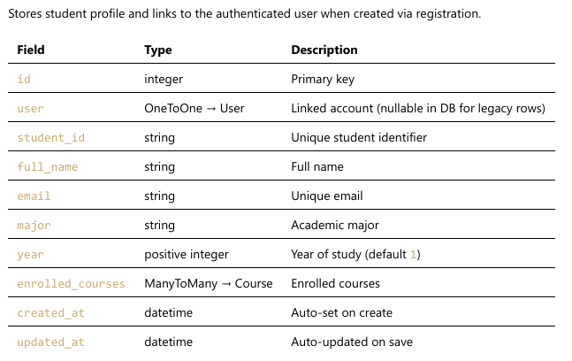
Data Model and Architecture

Slide 5
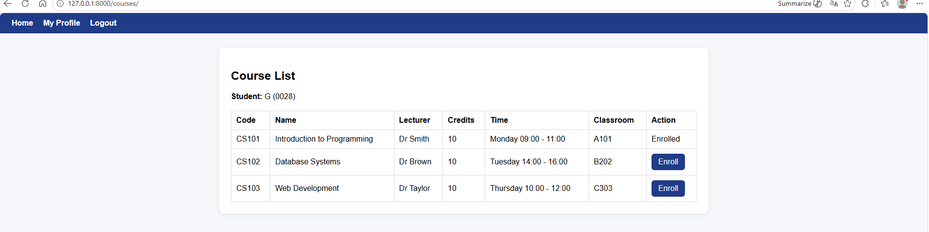
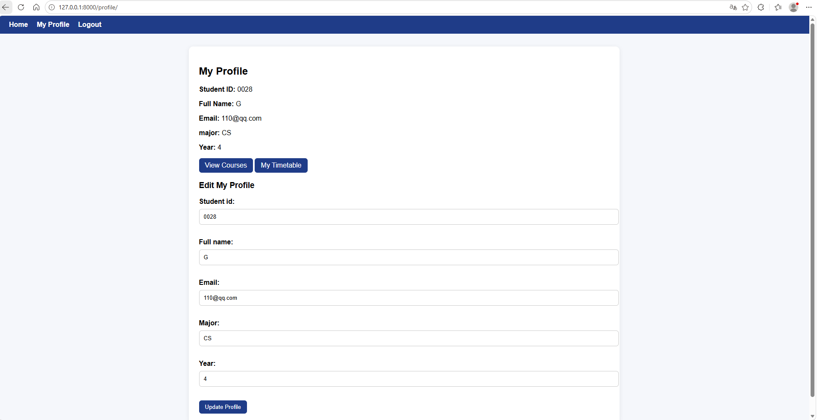
Main Features and Demo Screens
Web Features
Registration / Login / Logout
My Profile
Course List
Enrolment
My Timetable
Drop Course
API Features
Student CRUD JSON endpoints
Session-based authentication
HTTP status codes and JSON responses

Slide 6
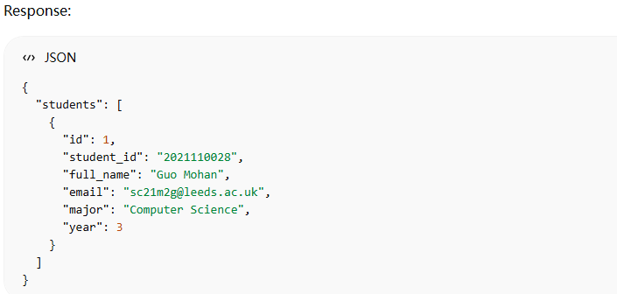
API Documentation and Example Endpoint
API documentation written in Markdown and exported as PDF committed into the github
Example of endpoints GET /api/students/

Slide 7
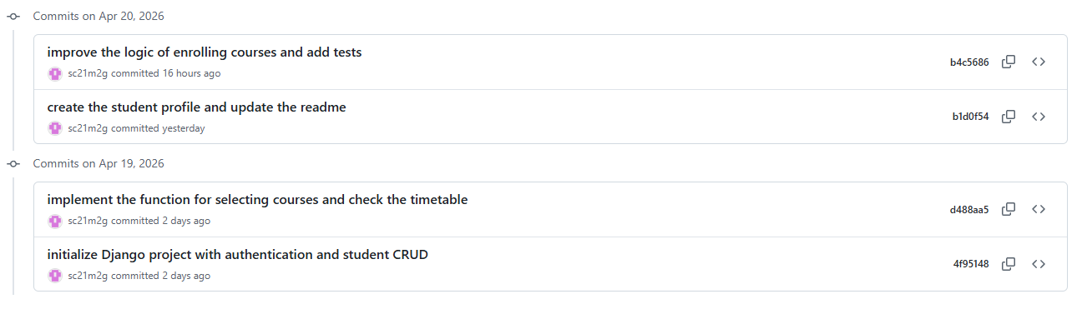
Iterative Development and Version Control
Version 1
Authentication
Navigation
Basic student CRUD
Student JSON API
Version 2
Course model
Enrolment
Timetable
Withdrawal
Version 3
Linked user and student profile
Self-service workflow
Improved profile logic
Automated tests

Slide 8
Testing, Limitations, and Conclusion
Testing
Manual workflow testing
Automated Django tests
13 tests passed successfully
Limitations
No role-based authorisation yet
Some error responses still rely on Django defaults
Local deployment only
Conclusion
Functional database-backed student information system
Combines web workflows and JSON API
Supports further extension

Slide 9
Thank you
Presenter name
www.officeplus.cn

